Slide 1

Data Mining on
Home Forestation
Presented By
Presented To
Shafiur Rahman
ID: 153-15-6462
Tanveer Hoque
ID: 153-15-6334
Shajjadul Haque
ID: 153-15-6365
Fahad Foisal
Assistant Professor
Department of CSE
Daffodil International University.

Slide 2
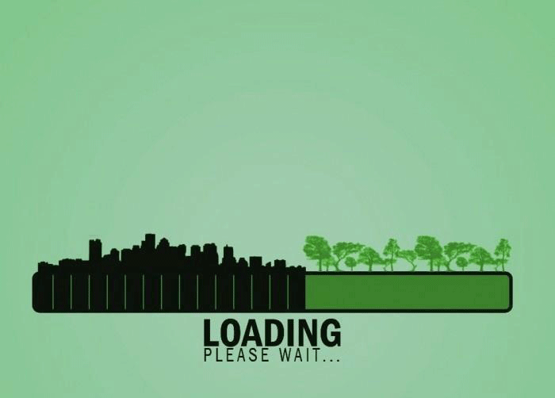
?

Slide 3


Slide 4
Blueprint of Workflow

Slide 5
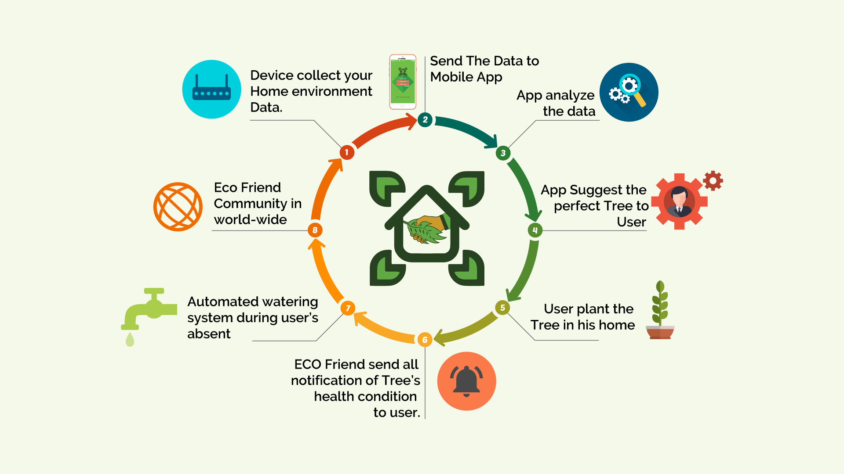
How Eco Friend Works

Slide 6
Diagram

Slide 7
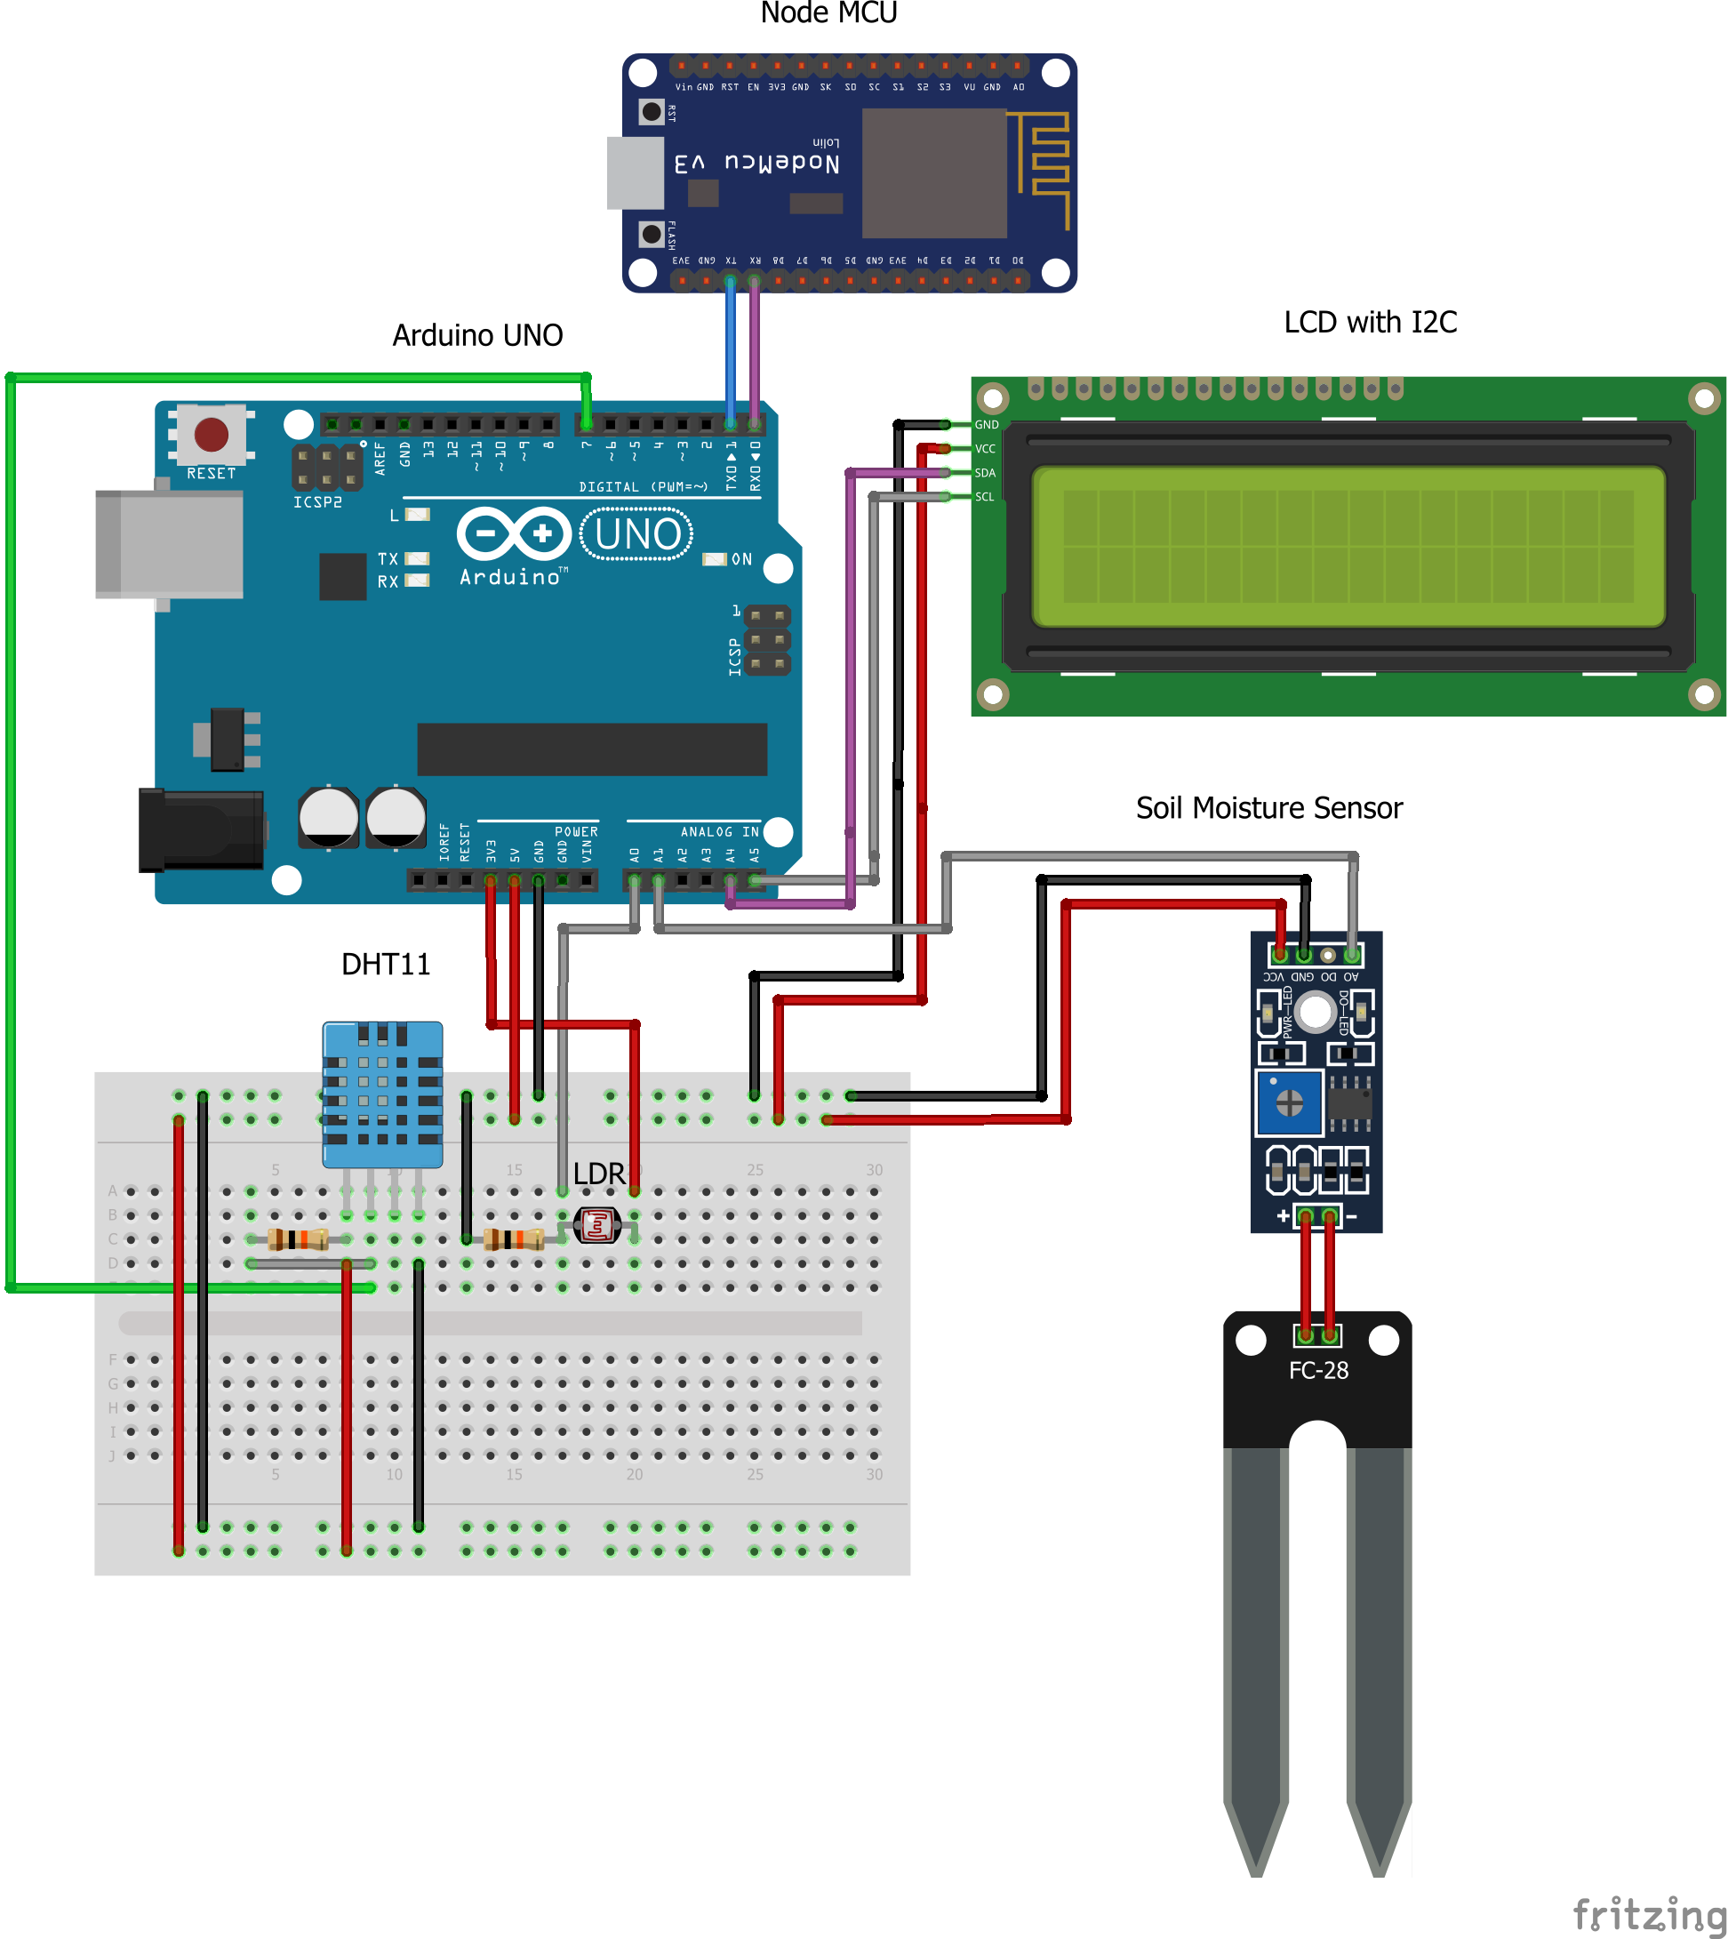
Diagram

Slide 8
Code Blocks

Slide 9
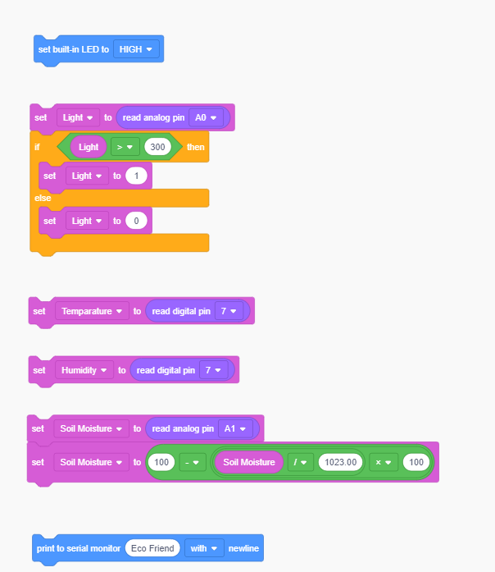
Code Diagram

Slide 10
ArduinoUNO Flowchart

Slide 11
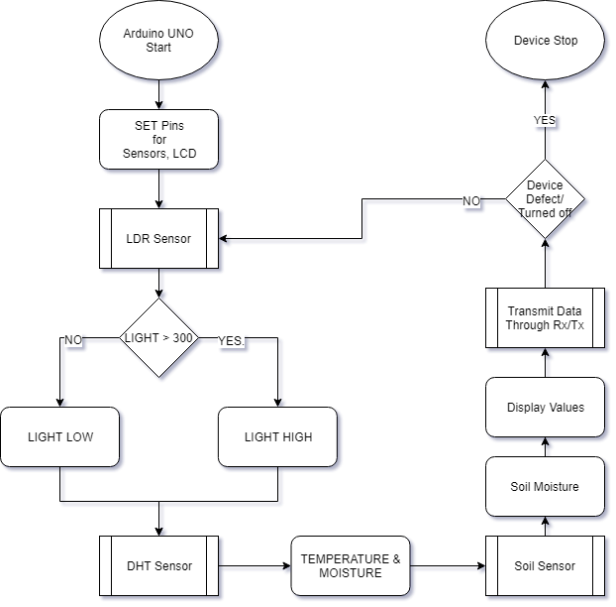
ArduinoUNO Flowchart

Slide 12
NodeMCU Flowchart

Slide 13
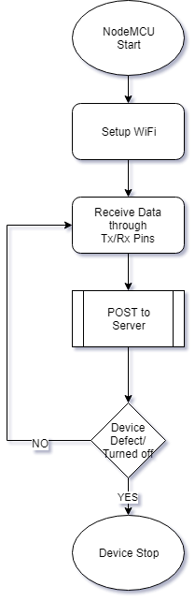
NodeMCU Flowchart

Slide 14
Server Flowchart

Slide 15
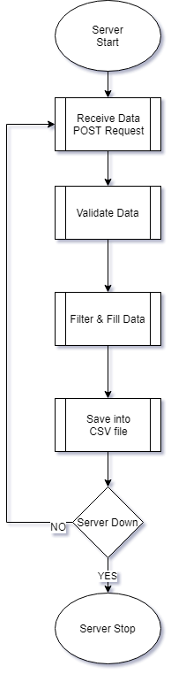
Server Flowchart

Slide 16
Data Mining Flowchart

Slide 17
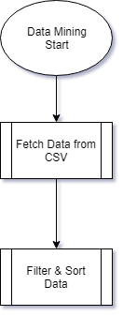
Data Mining Flowchart

Slide 18
App Flowchart

Slide 19
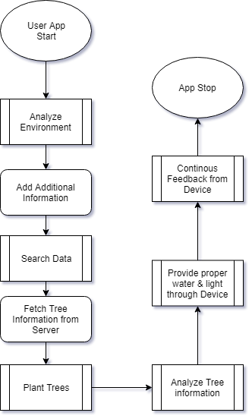
App Flowchart

Slide 20
App UI

Slide 21
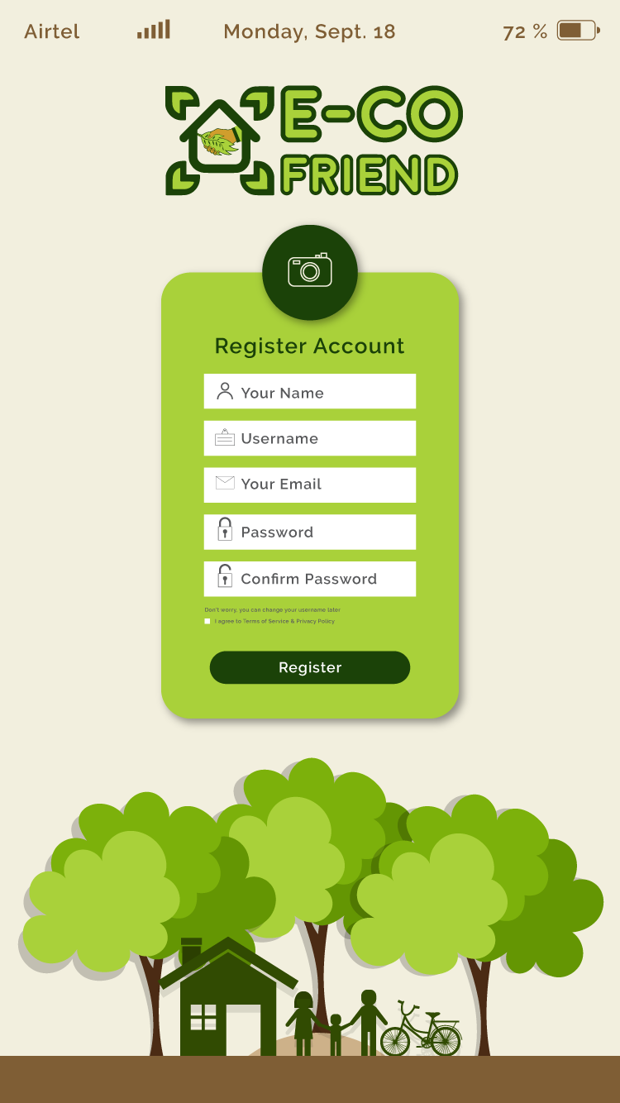
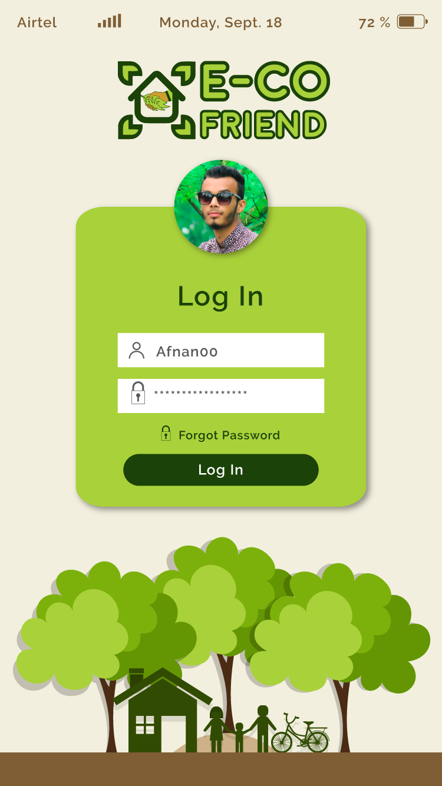
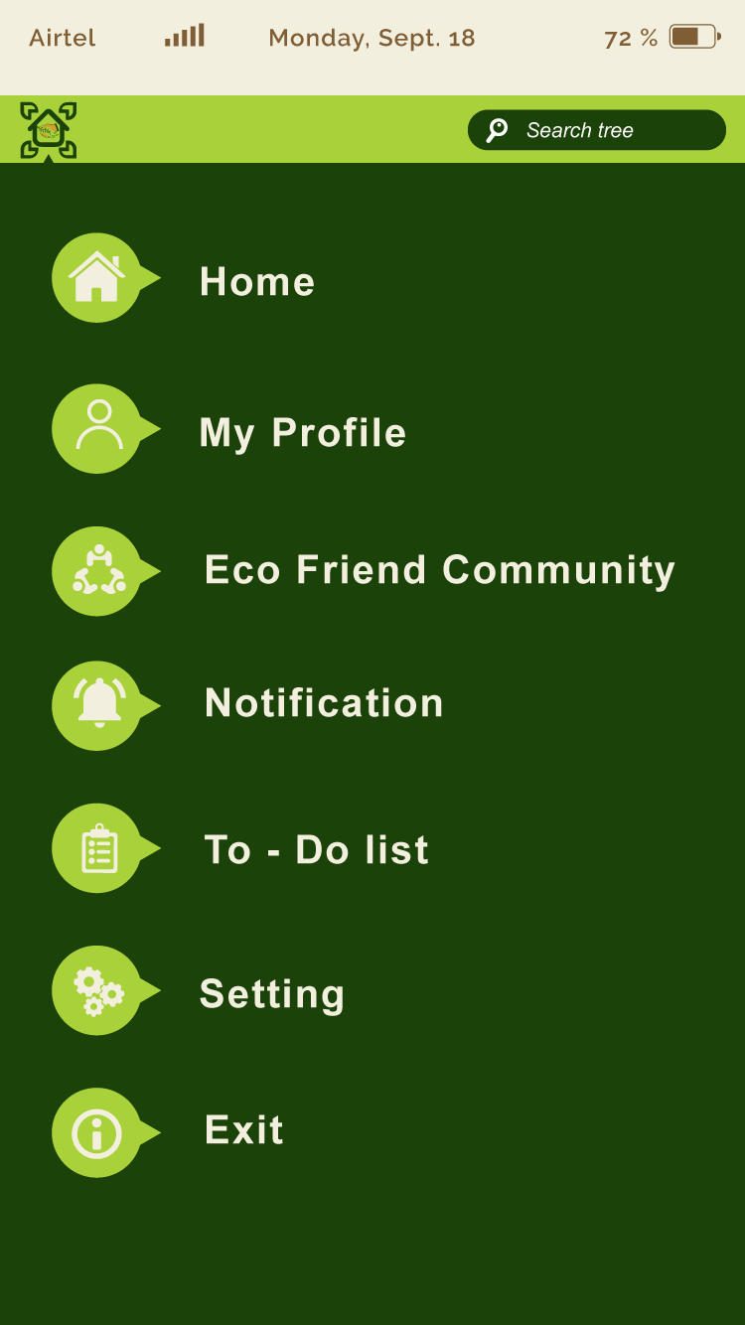
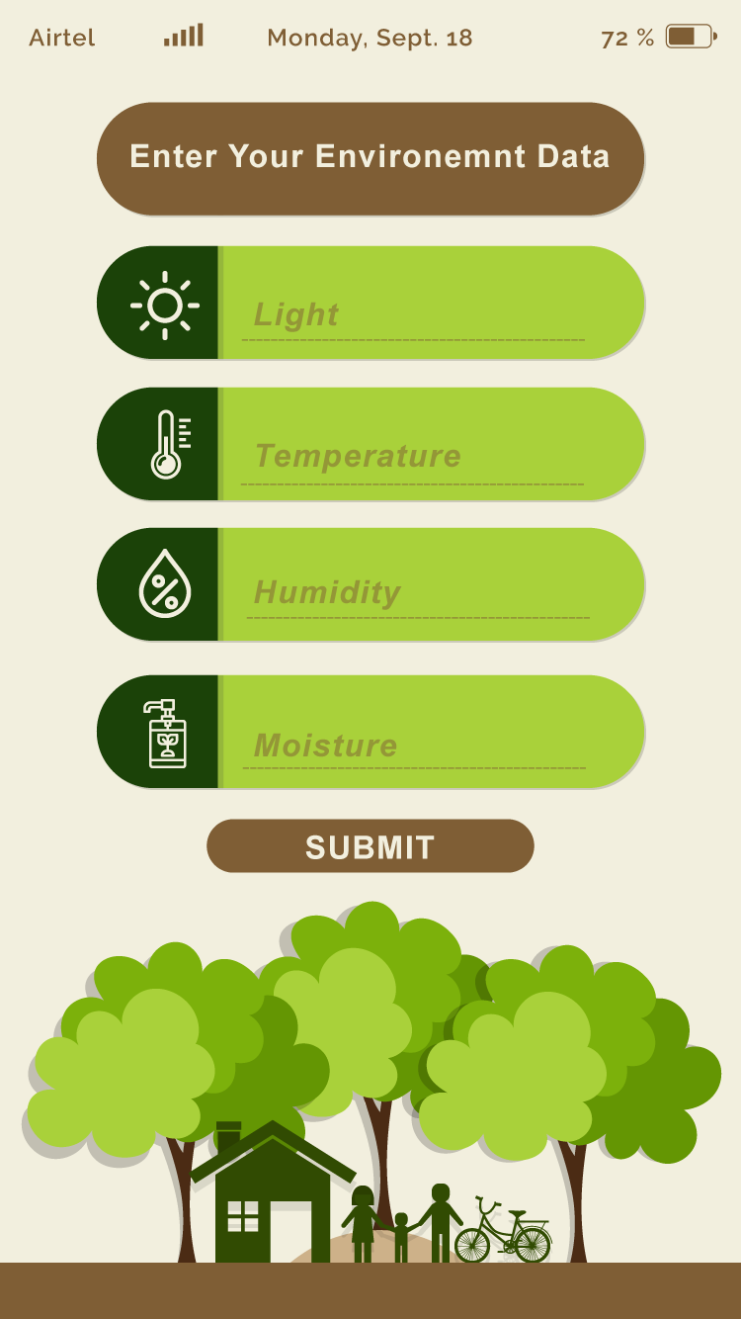
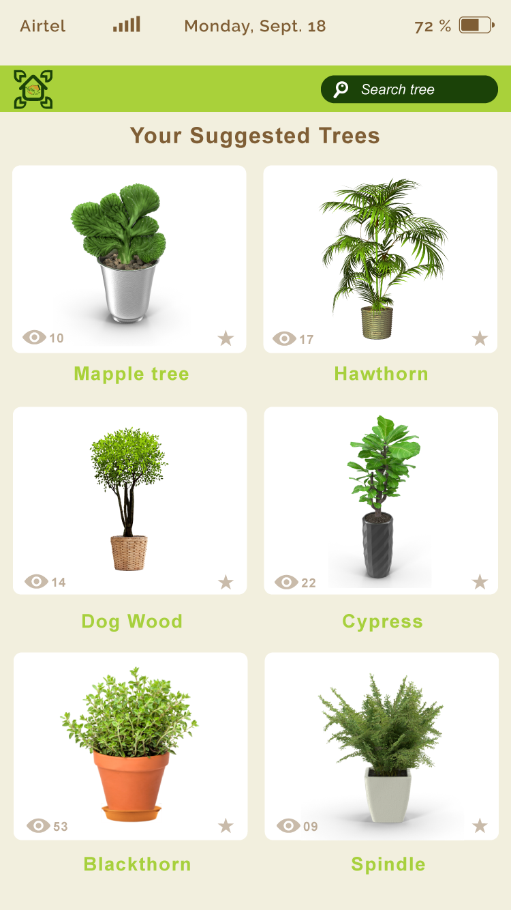
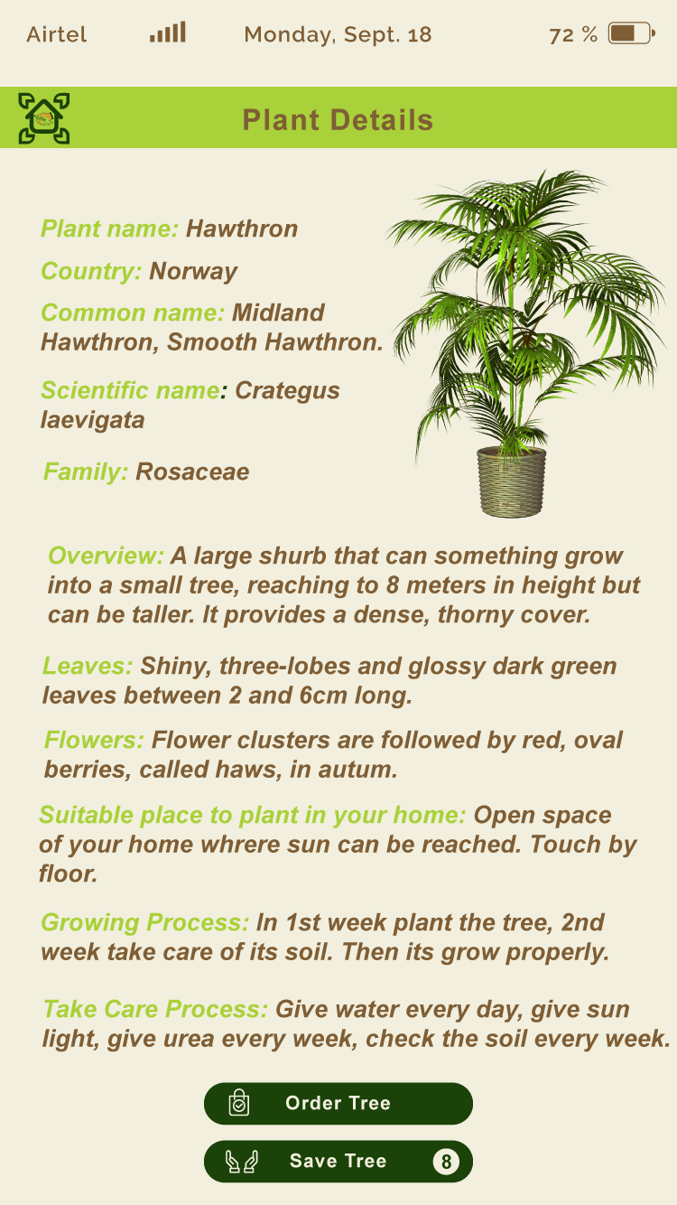
App UI
Registration
Login
Navigation
Search Trees
Select Tree
Tree Details

Slide 22
Difficulties Faced & Learnt
Changing analog values
Broken wires
LCD issues
Tx/Rx Pin Plug
Expensive to experiment
Soil Sensor is corrutted in salt
Single char issues
MySQL & JDBC driver
Proteus & Tinkercad Parts limitation
Tinkercad Library import limitation
Fritzing Board selection limitation

Slide 23
Things used
Arduino IDE
Proteus
Platform.io
Fritzing
Xampp
Heroku
Tinkercad
Draw.io
Arduino
PHP
CSV
SoftwareSerial
LiquidCrystal_I2C
Dht
ESP8266WiFi
WiFiClient
ESP8266WebServer
ESP8266HTTPClient

Slide 24
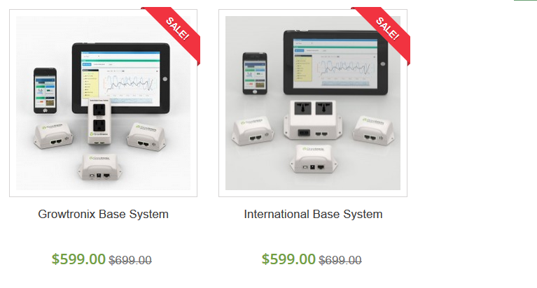

Other Similar Devices
Growtronix
Niwa

Slide 25
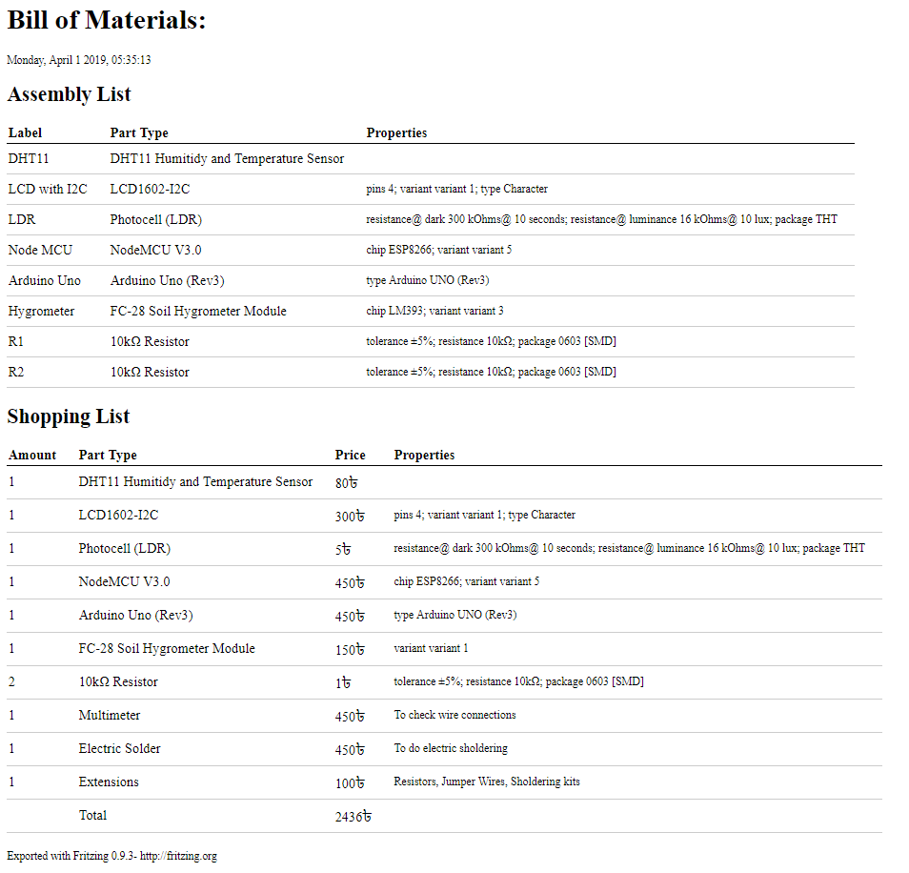
Parts & Expense

Slide 26

What iF?

Slide 27


